Slide 1
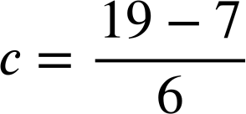
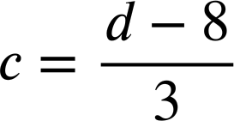
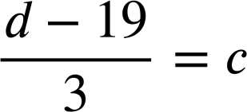
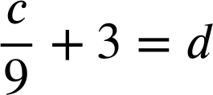
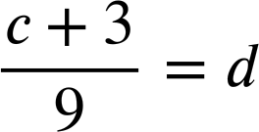
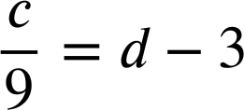




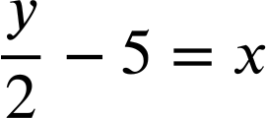

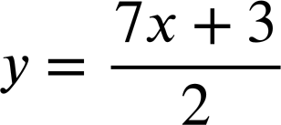
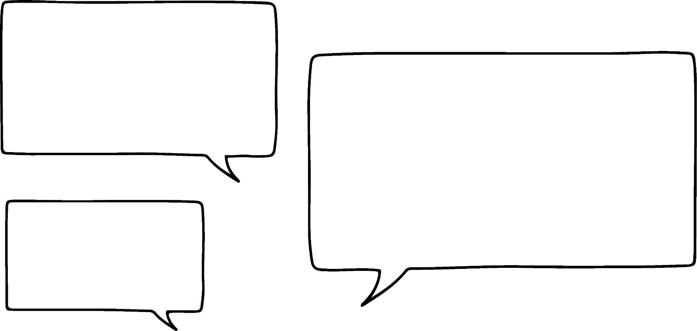

Changing the subject with more complex formula
Task A: Changing the subject with two steps
1) Rearrange each formula to make c the subject.
a)
6c + 7 = 19
b)
3c + 8 = d
6c = 19 − 7
3c = d − 8
c)
3d − c = 19
d)
d − 3c = 19
3d = 19 + c
d = 19 + 3c
3d − 19 = c
d − 19 = 3c
e)
f)
2) Laura has been rearranging these equations to make y the subject.
In each case circle Laura’s errors and write a sentence to explain what she should do differently.
a)
2y + 3x = 18
b)
c)
2y + 3 = 7x
2y = 18 − 3x
y − 5 = 2x
2y = 7x + 3
For y to be the subject the coefficient needs to be 1. Divide both sides by 2
y = 2x + 5
I have checked my answers and they are all wrong. Can you help me spot where I went wrong?
When multiplying both sides by 2 be sure to multiply all terms. This line should read y − 10 = 2x
You meant to add −3 to both sides

Slide 2
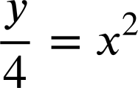

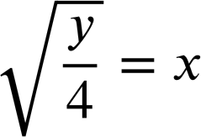
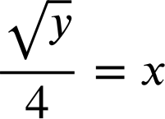
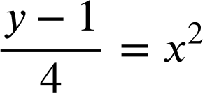
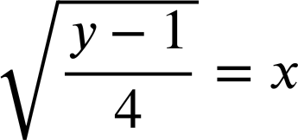
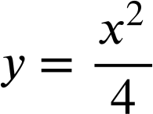
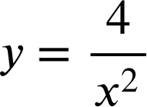
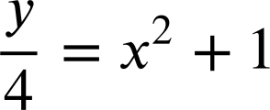


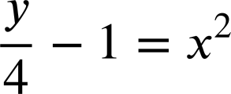
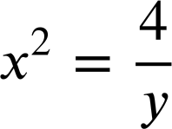

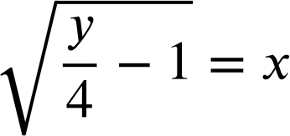
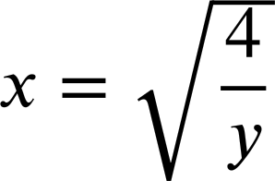



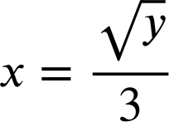

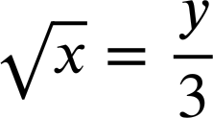
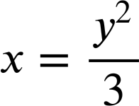
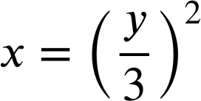
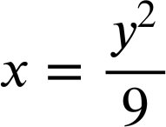
Changing the subject with more complex formula
Task B: Rearranging more complex formula
1) Rearrange each formula to make x the subject.
a)
y = 4x²
b)
y = (4x)²
c)
y = 4x² + 1
y − 1= 4x²
d)
y = 4(x² + 1)
e)
f)
g)
h)
i)
Mathematics in Education and Industry
v2.3

